Slide 1
BOOTSTRAP
BOOTSTRAP =
(GRID SYSTEM + CLASSES+ COMPONENTS)
Grid system- gives responsiveness
Classes (img-fluid)
Components – buttons, form, alert, pagination

Slide 2


Create web application responsive
Bootstrap is the most popular HTML, CSS, and JavaScript framework for developing responsive, mobile-first web sites.
Bootstrap is completely free to download and use!

Slide 3
Bootstrap
Bootstrap is a free front-end framework for faster and easier web development.
Bootstrap includes HTML and CSS based design templates for typography, forms, buttons, tables, navigation, modals, image carousels and many other, as well as optional JavaScript plug-in
Bootstrap also gives you the ability to easily create responsive designs.
Responsive web design is about creating web sites which automatically adjust themselves to look good on all devices, from small phones to large desktops.

Slide 4
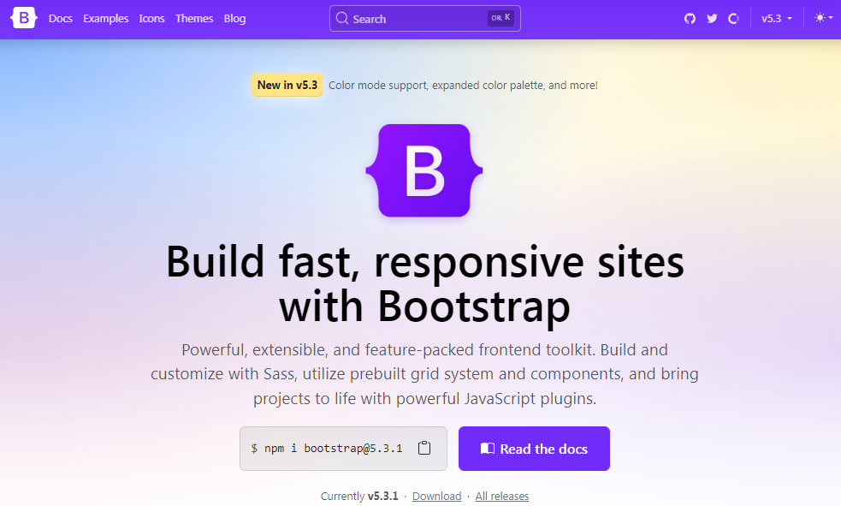
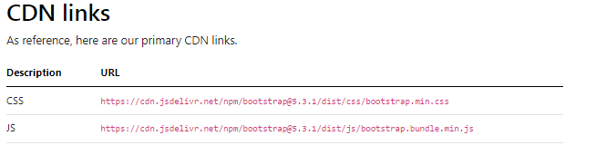
Bootstrap
A basic understanding of HTML is required to start learning Bootstrap. Some familiarity with how CSS works (CSS Selectors and Visual Rules) would be helpful,
Download Bootstrap from getbootstrap.com
There are 2 ways to attach and use bootstrap
Include Bootstrap from a CDN(fast)
Download & attach(slow)

Slide 5
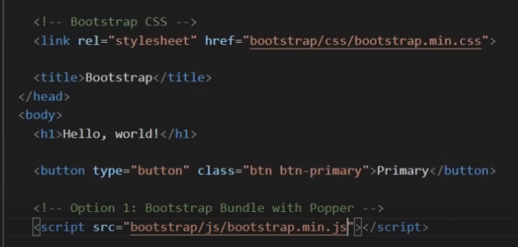
Exercise :
Create simple index page with links to bootstrap library.
use CDN Add button and check the code
downloaded bootstrap code (Use vs code editor) Add button and check the code
Download and Using direct file names js & css

Slide 6
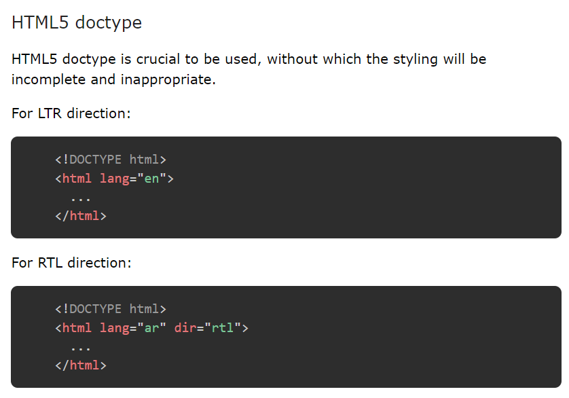
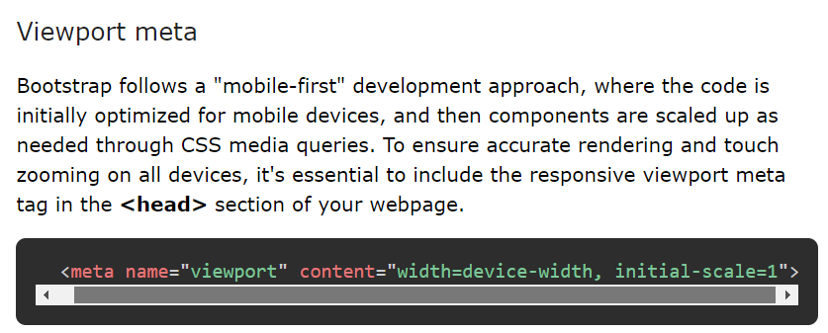

Slide 7
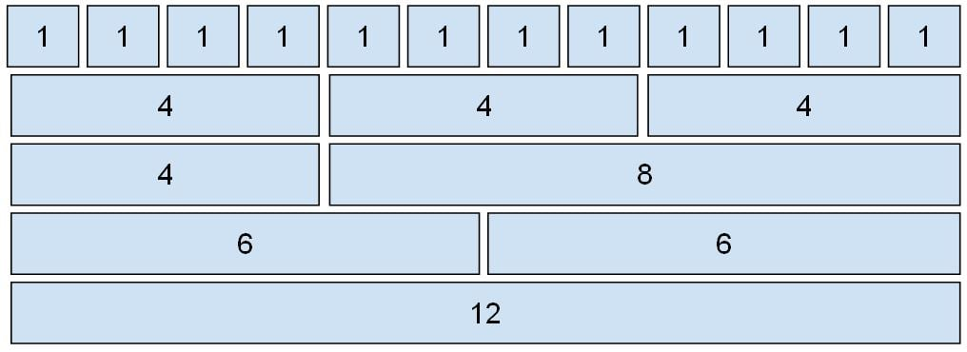
GRID SYSTEM
Grid System allows up to 12 columns across the page. You can use each of them individually or merge them together for wider columns. All combinations of values summing up to 12 can be used.

Slide 8
Grid Classes: Bootstrap grid system contains six classes which are listed below:
.col- It is used for extra small screen devices (screen width less than 576px).
.col-sm- It is used for small screen devices (screen width greater than or equal to 576px).
.col-md- It is used for medium screen size devices (screen width greater than or equal to 768px).
.col-lg- It is used for large screen size devices (screen width greater than or equal to 992px).
.col-xl- It is used for xlarge screen size devices (screen width equal to or greater than 1200px).
.col-xxl- It is used for xxlarge screen size devices (screen width equal to or greater than 1400px).

Slide 9
Components of Grid System:
Containers: Bootstrap requires a containing element to wrap site contents in a grid system. The word container is used to contain the row elements and row elements containing the column elements.
Rows: Rows must be placed within the container or container-fluid for proper alignment and padding. Rows are used to create horizontal groups of columns.
Columns: Grid columns are created by specifying the number of twelve available columns you wish to span. For example, three equal columns would use three col-lg-4.

Slide 10
Example 1: This example uses bootstrap to create an equal width column grid on all devices and screen widths.

Slide 11
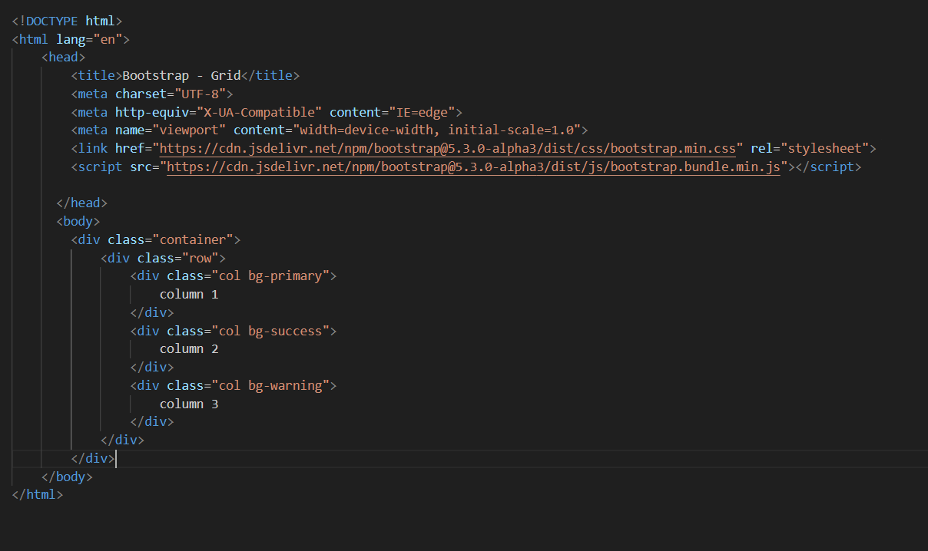

Slide 12
Example 2: This example uses bootstrap to create equal width responsive column grid. When the screen size is less than 576px the column automatically stack to each other.

Slide 13
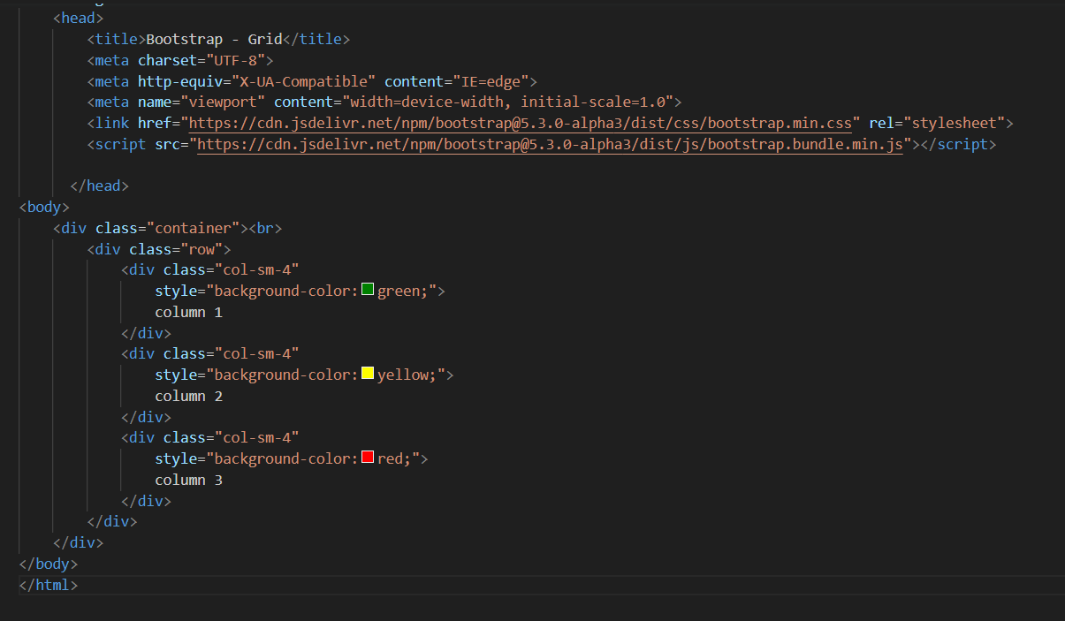

Slide 14
Example 3: This example uses bootstrap to create unequal width responsive column grid. When the screen size is less than 576px the column automatically stack to each other.

Slide 15
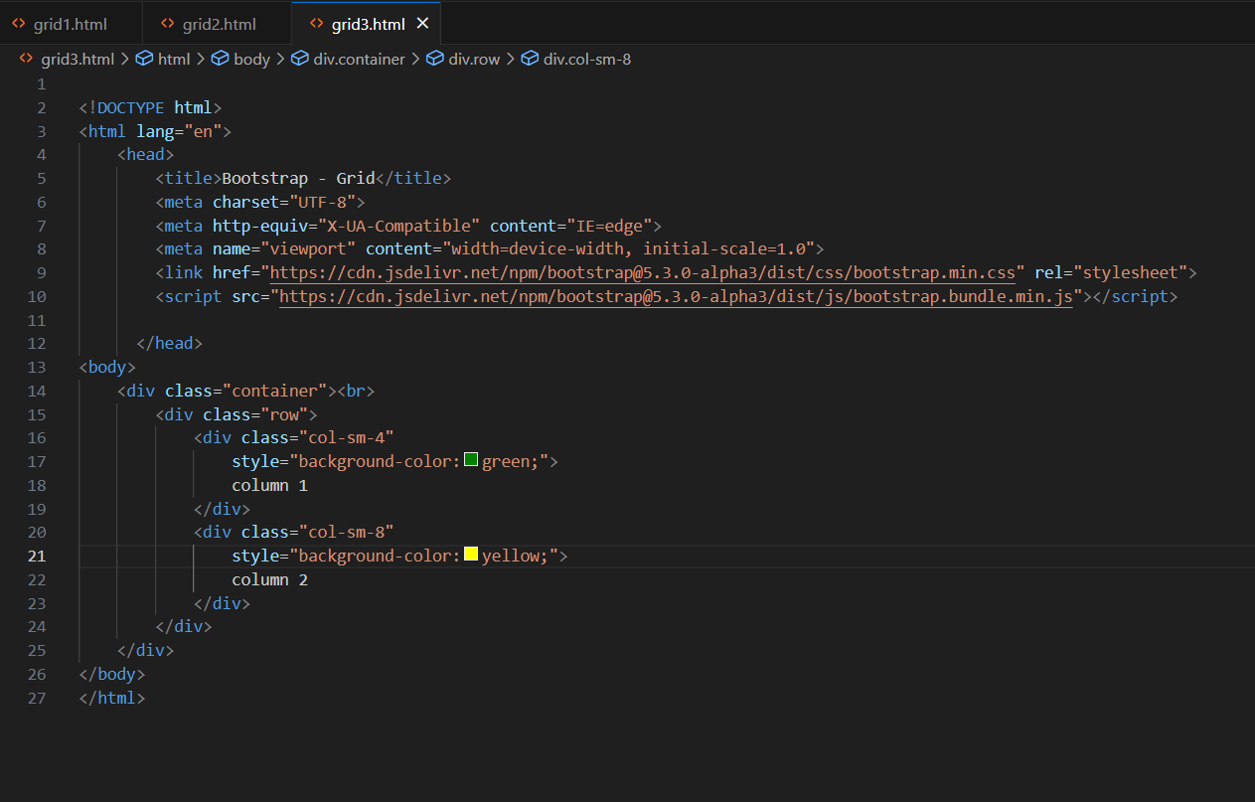

Slide 16
Containers in Bootstrap with examples
In bootstrap, the container is used to set the content’s margin. It contains row elements and the row elements are containers of columns. This is known as the grid system. There are two container classes in bootstrap:
.container
.container-fluid

Slide 17
container
.container: The .container class provides a responsive fixed width container. In the below example, the div with class “container” will have a fixed left and right margin and will not take the complete width of its parent or the viewport.

Slide 18
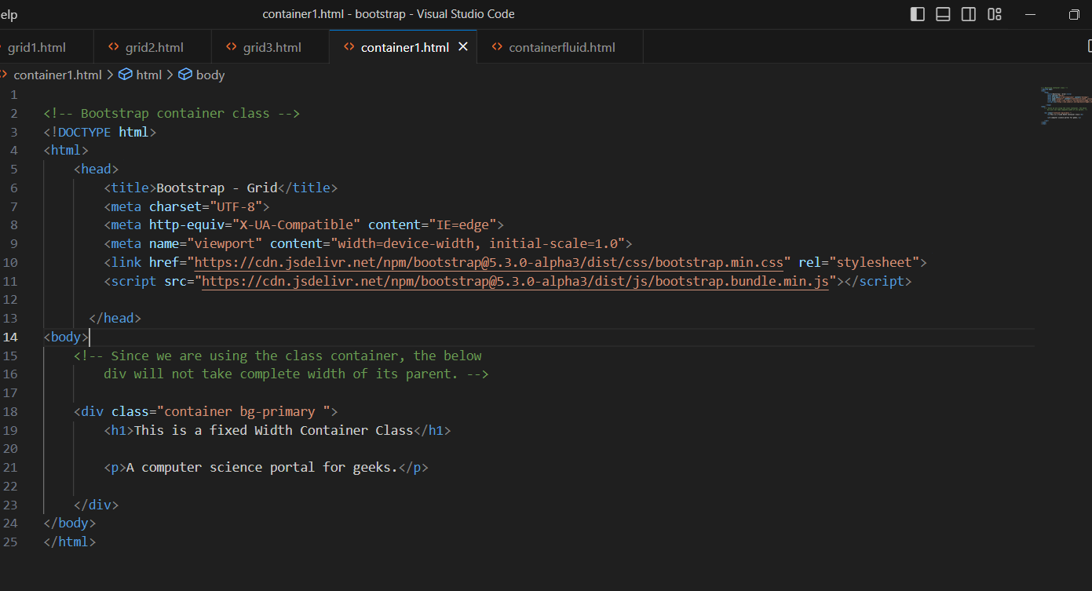

Slide 19
container-fluid
.container-fluid: The .container-fluid class provides a full-width container which spans the entire width of the viewport. In the below example, the div with class “container-fluid” will take up the complete width of the viewport and will expand or shrink whenever the viewport is resized.

Slide 20
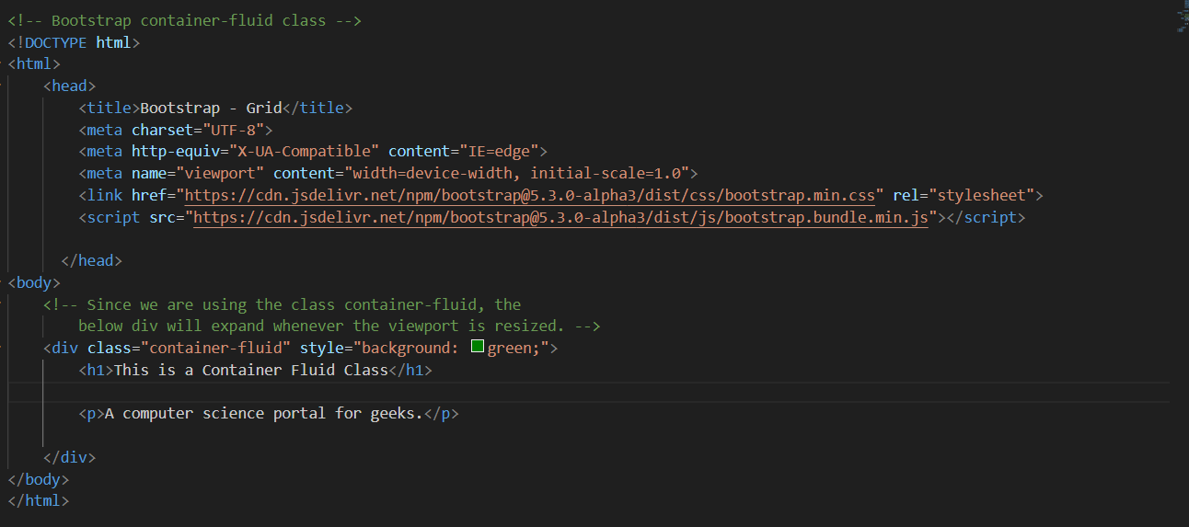

Slide 21
Navigation Bar
A navigation bar is used in every website to make it more user-friendly so that the navigation through the website becomes easy and the user can directly search for the topic of their interest. The navigation bar is placed at the top of the page.

Slide 22
Navigation Bar
Example 1:
Show the Basic Navigation Bar: The .navbar class is used to create a navigation bar. The navbar is created responsive by using .navbar-expand-xl|lg|md|sm class. The responsive navbar is vertically stacked in small screens. The <class=”nav-item”> element followed by <a class=”nav-link”> is used to create nav link.
Example 2:
Show the Dropdown Navbar: The navbar can be created by using dropdown menu.
Example 3:
Show the Colored Navbar :The default is our “light navbar” for use with light background colors, but you can also apply data-bs-theme="dark" to the .navbar parent for dark background colors. Then, customize with .bg-* and additional utilities.

Slide 23
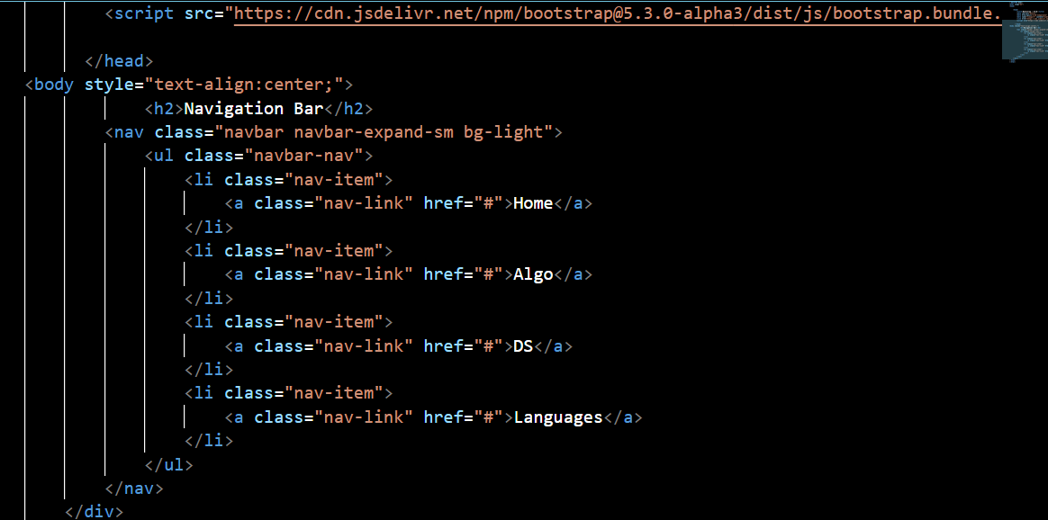

Slide 24
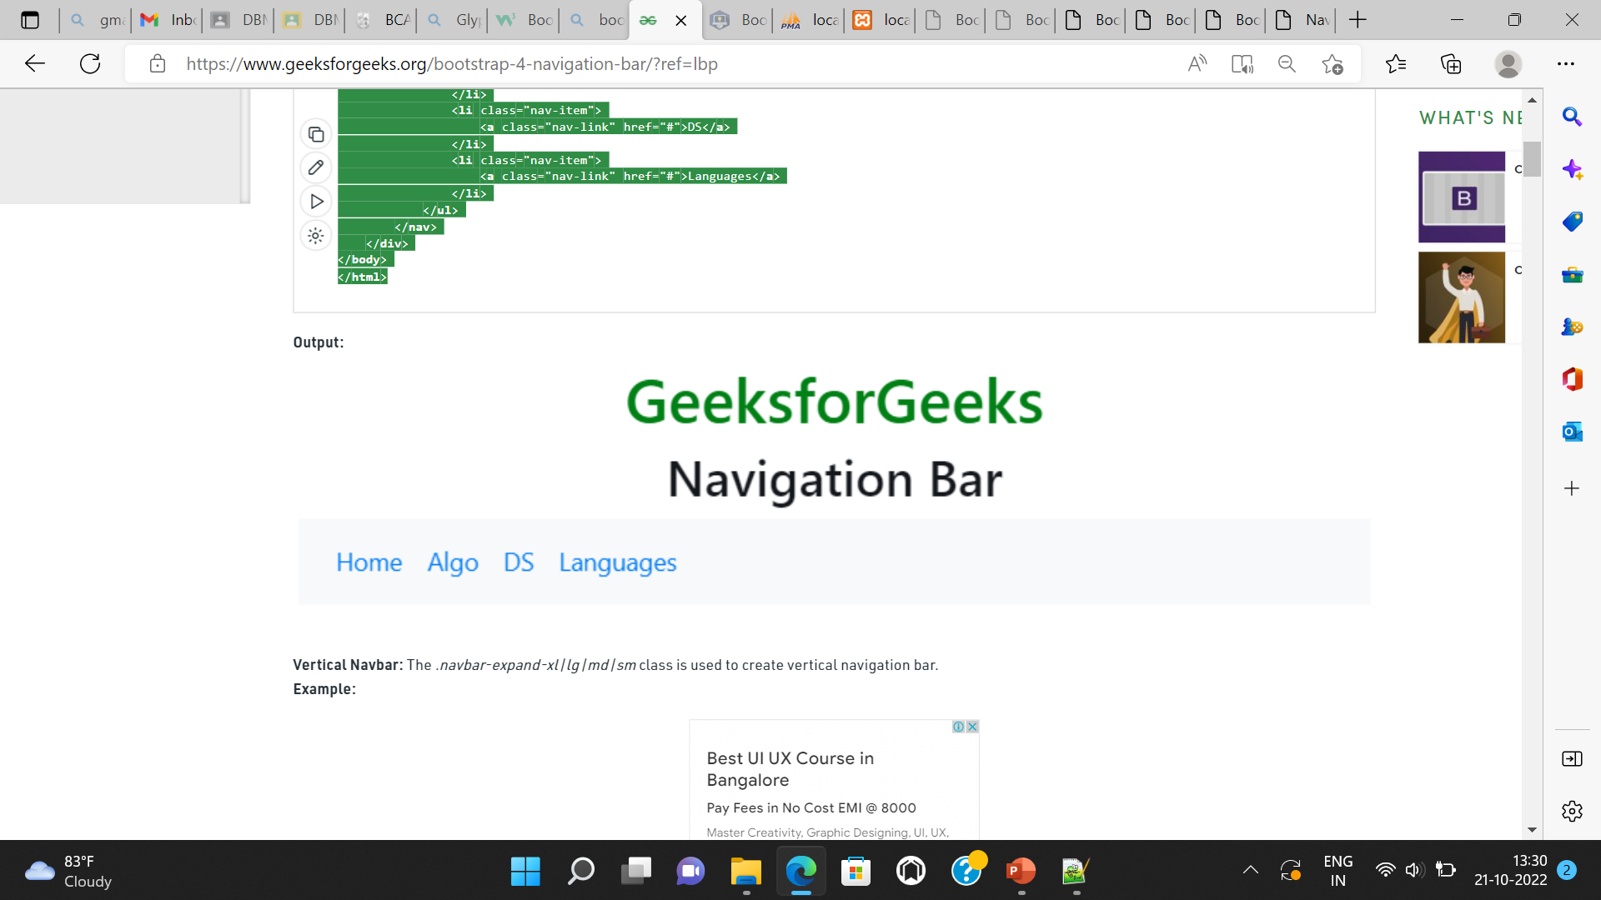

Slide 25
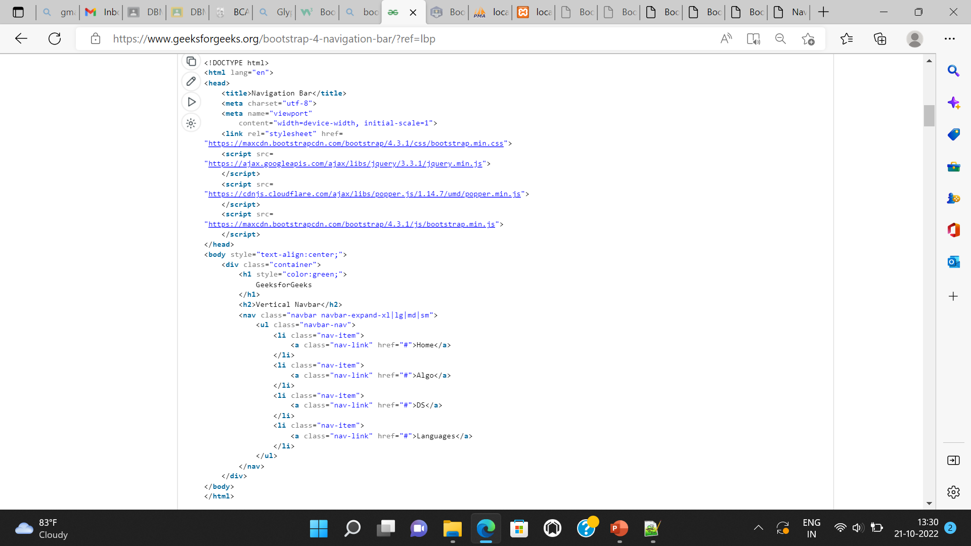

Slide 26
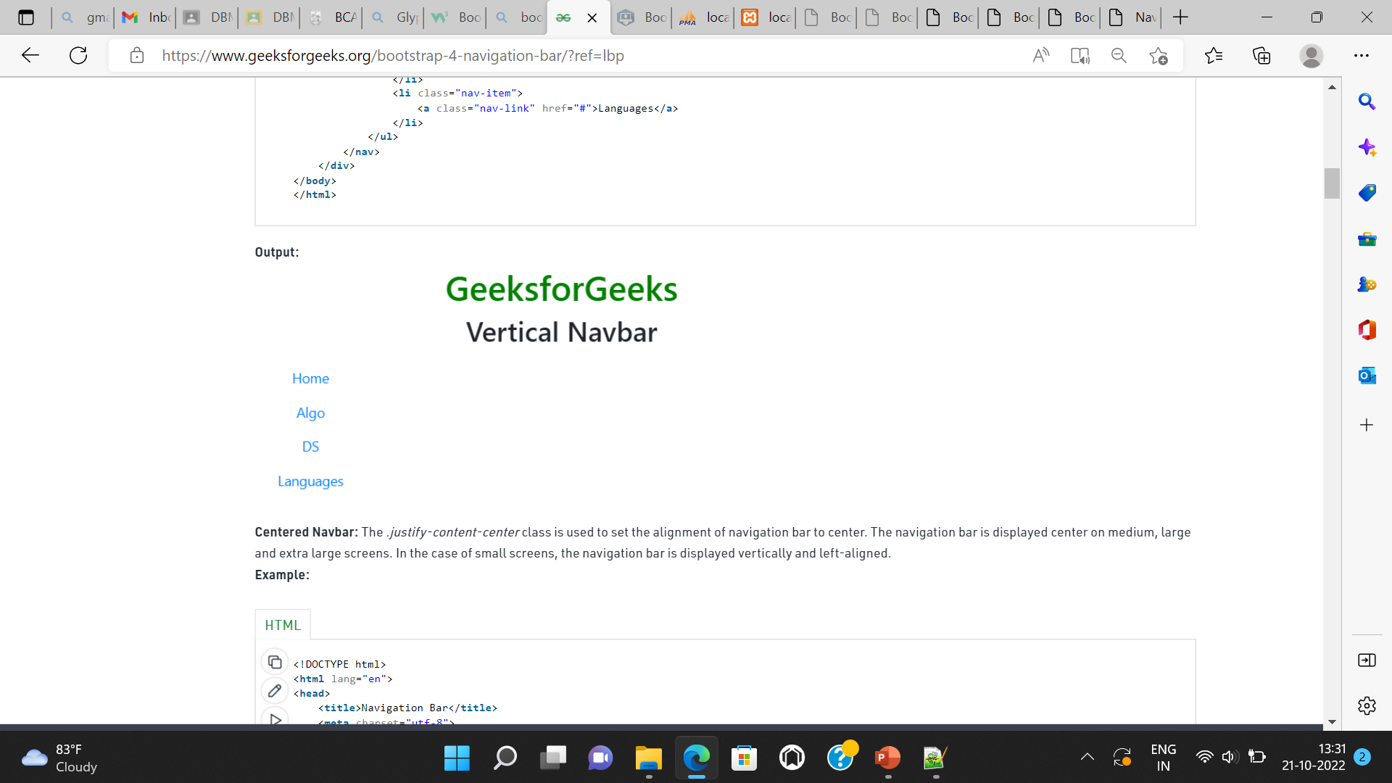

Slide 27
Dropdown Navbar: The navbar can be created by using dropdown menu.

Slide 28
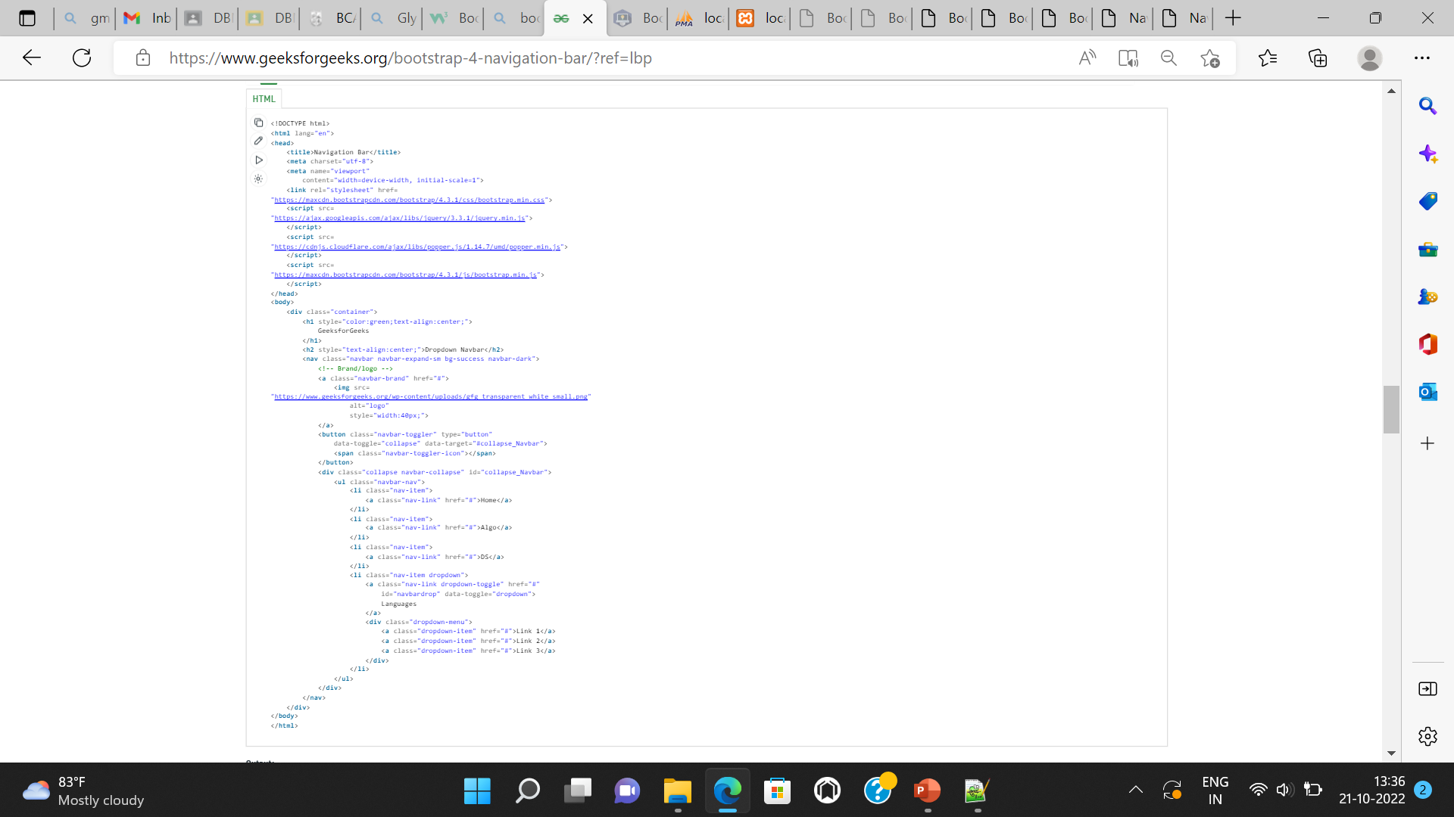

Slide 29
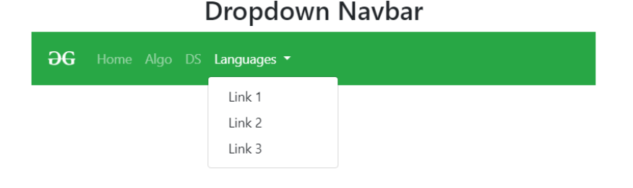

Slide 30
Carousel
The Bootstrap Carousel is used to create an image slide show for the webpage to make it look more attractive. It can be included in the webpage using bootstrap.js or bootstrap.min.js. Carousels are not supported properly in Internet Explorer, this is because they use CSS3 transitions and animations to achieve the slide effect.
example 1:
Show Bootstrap Carousel with caption, indicator and Autoplaying feature.

Slide 31
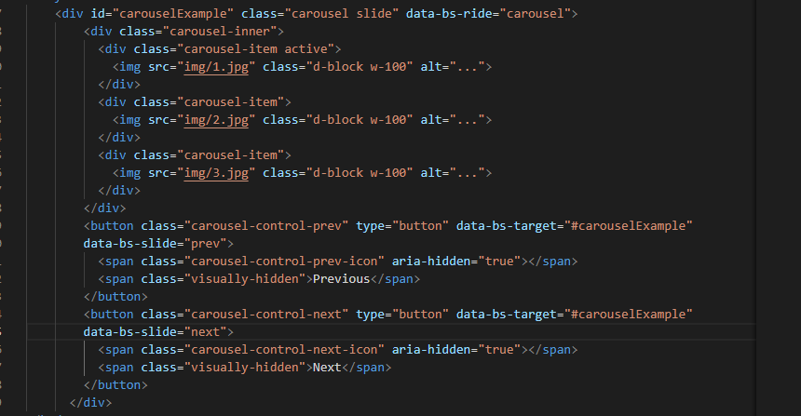

Slide 32
glyphicons
Bootstrap provides set of graphic icons, symbols and fonts called Glyphicons. Some Glyphicons like Home icon, User icon, Lock icon, etc. Generally, Glyphicons are icon fonts which you can use in your web projects. Bootstrap 3 includes 260 glyphicons. Glyphicons Halflings are not available for free of cost, but their creator has made them available for Bootstrap free of cost.
Bootstrap 4 does not have its own icon library (Glyphicons from Bootstrap 3 are not supported in BS4). However, there are many free icon libraries to choose from, such as Font Awesome and Google Material Design Icons.

Slide 33
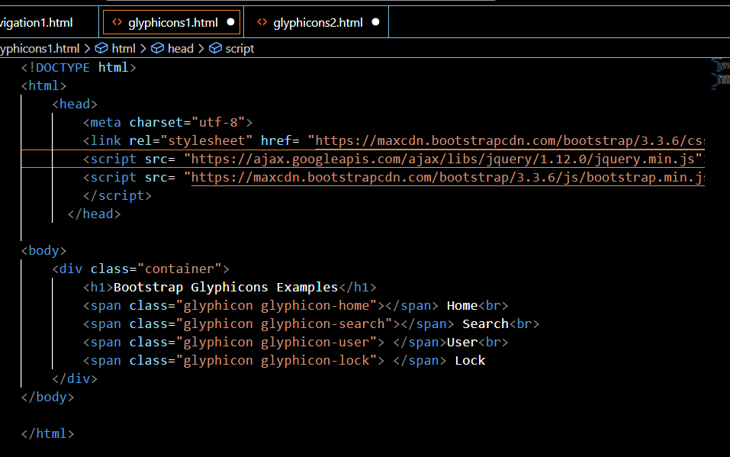

Slide 34
Tables
Bootstrap provides a series of classes that can be used to apply various styling to the tables such as changing the heading appearance, making the rows stripped, adding or removing borders, making rows hoverable, etc. Bootstrap also provides classes for making tables responsive.
Simple Table: The .table class is used to create a simple Bootstrap table. This class name is used with the <table> tag to create a table.
table class="table"> Table Contents... <table>

Slide 35
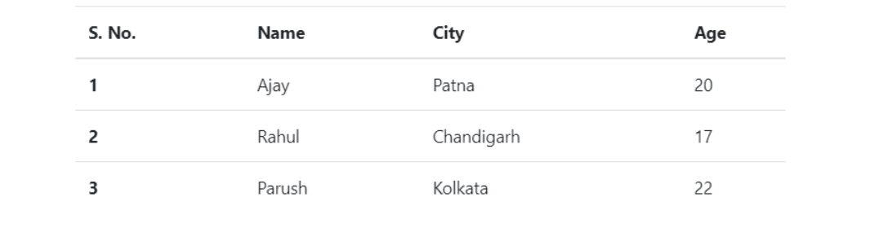
Simple table

Slide 36
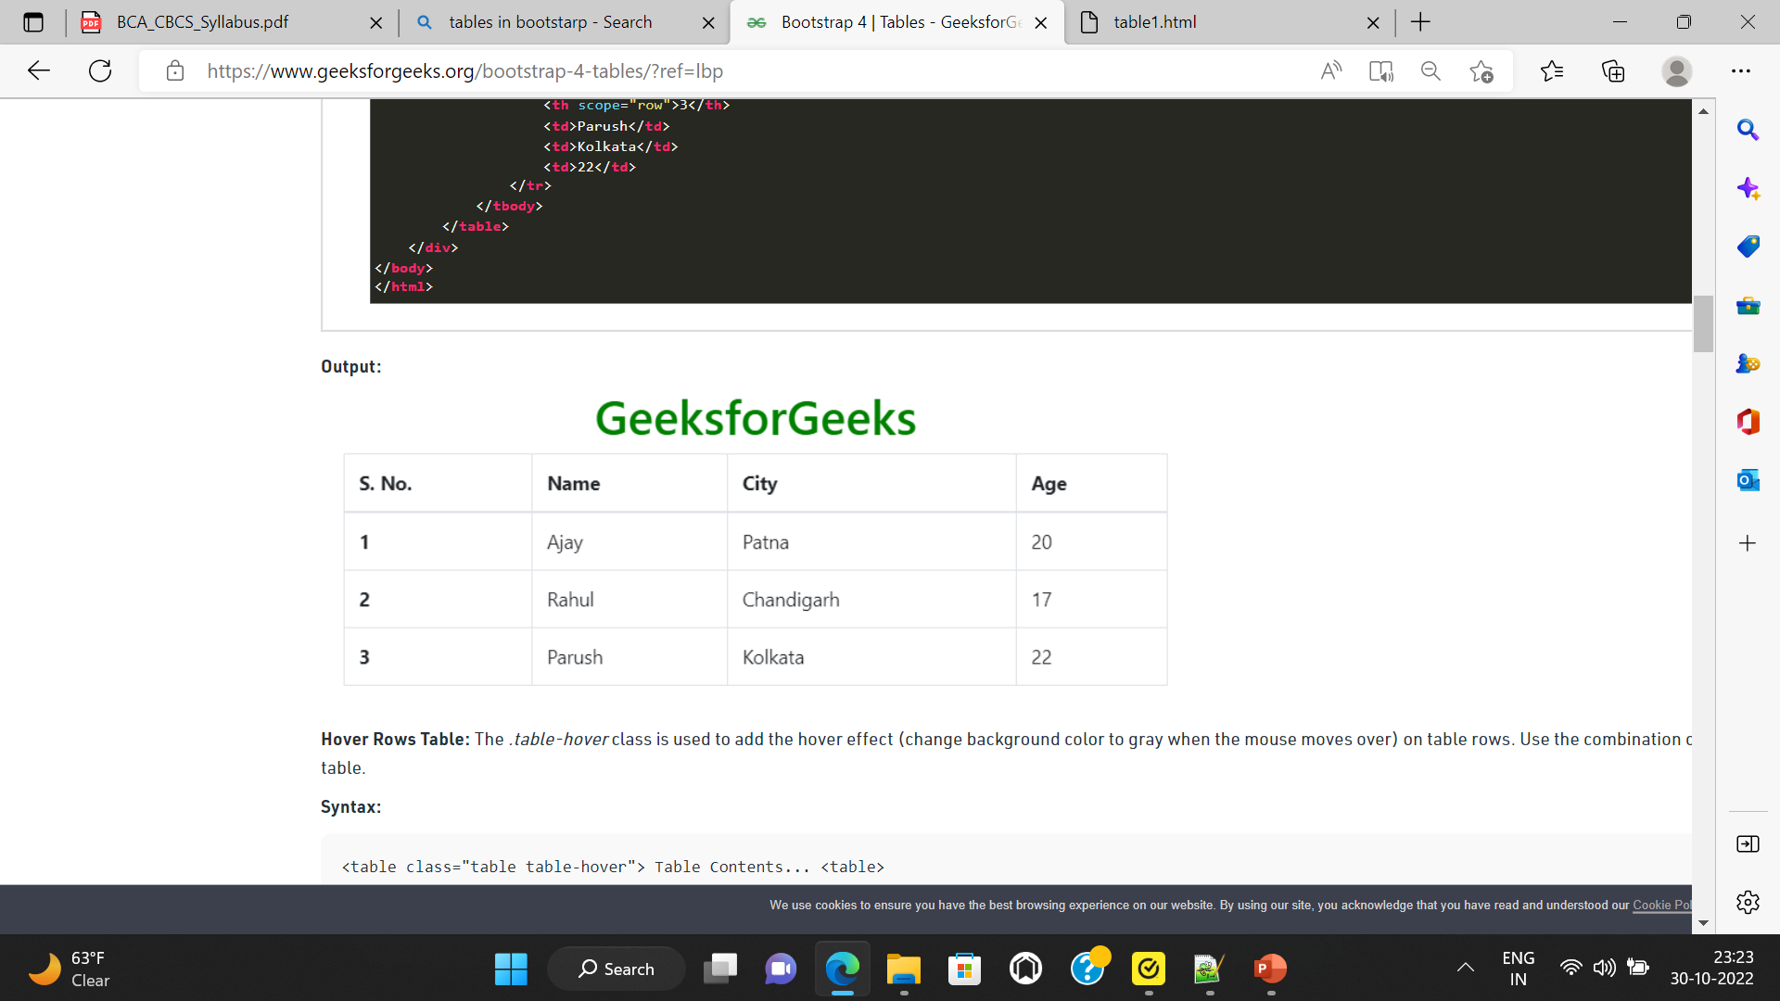
<table class="table table-bordered"> Table Contents... <table>

Slide 37
table class="table table-dark"> <table class="table table-hover"> <table class="table table-dark table-hover">
<

Slide 38
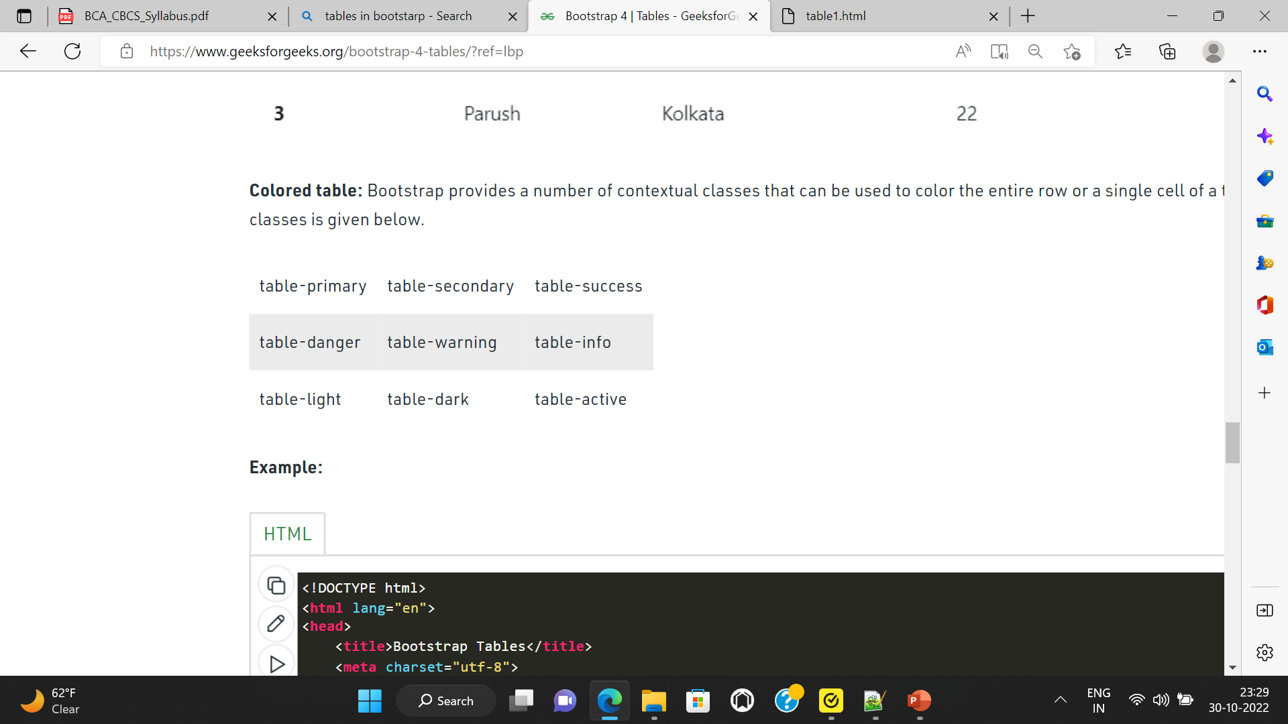
Colored table: Bootstrap provides a number of contextual classes that can be used to color the entire row or a single cell of a table. These classes should be used with a light table and not with a dark table for a better appearance. The list of contextual classes is given below.

Slide 39
BOOTSTRAP TABLE
Example 1 create a simple table using bootstrap
Example 2 create a striped column using bootstrap , use table hover feature.
Example 3:
create a table with different colors for individual rows.

Slide 40
Images
Bootstrap offers different classes for images to make their appearance better and also to make them responsive. Making an image responsive means it should scale according to its parent element. That is, the size of the image should not overflow its parent element and will grow and shrink according to the change in the size of its parent without losing its aspect ratio.
The different classes available in Bootstrap for images are as explained below:

Slide 41
Example 1: write bootstrap code to show the following :
1. Responsive Images: The .img-fluid class is used within the <img> tag to create the responsive image. The responsive image is used to adjust the image automatically to the specified box.
<img src="image_source" class="img-fluid" ...>
2. Rounded Corners Image: The .rounded class is used to create a rounded corner image. This class is used with <img> tag.
img src="image_source" class="rounded“
3. Circle Image: The .rounded-circle class is used to create the circle shape image
img src="image_source" class="rounded-circle“
4. Thumbnail Image: The .img-thumbnail class is used to create a thumbnail (bordered) image.
<img src="image_source" class="img-thumbnail" ...>

Slide 42
Forms
Form Layout: Bootstrap provides two types of form layout which are listed below:
Example 1
Stacked form
Example 2
Inline form

Slide 43
Reference:
https://getbootstrap.com/docs/5.3/

